Slide 1


Palindrome Detector in 8086 Assembly
A robust, low-level string manipulation utility.
Presented by:
Abdul Rafay (Roll No: 243705)
Abdullah Rafay (Roll No: 243619)
Subject: COAL
Submitted To: Engr. Anum Aftab
Section: Bs Cyber Security – A

Slide 2
Contributions
Abdullah Rafay - 243619
Abdul Rafay - 243705
Documentation:
Documentation:
Project Proposal
Project Presentation 50%
Project Report
Project Presentation 50%
Code implementation:
Code implementation:
Role: Data Processing & System Flow
  Input Sanitization
  Buffer Management
  Logic Control
Role: Core Algorithm & Output Logic
  Comparison Engine
  Case Normalization
  Result Formatting

Slide 3
Project Overview & Problem Statement
Design & Implementation
Specific Objectives
Dynamic Input: Accept strings of varying lengths (up to 80 chars).
Fully functional Palindrome Checker using 8086 Assembly Language.
Manual Reversal: Implement algorithms to reverse strings in memory.
Comparisons: Perform accurate character-by-character validation.
Core Functionality
Accepts user input, processes it, and determines if it reads the same forward and backward.

Slide 4
Introduction & Problem Statement
What is a Palindrome?
The Challenge in Assembly
A sequence of characters reading the same forward and backward (e.g., "MADAM", "racecar").
High-level languages have built-in reversal functions; Assembly does not. Requires manual handling of:
Memory allocation for strings.
Byte-by-byte comparison loops.
ASCII arithmetic for case conversion.

Slide 5
Key Innovations (Unique Features)
Dynamic String
Length
Case-Insensitivity
Advanced Sanitization
Converts all input to Uppercase before checking; "Madam" matches "madam".
Filters out spaces, punctuation, and symbols for sentence-level checking (e.g., "Madam, I'm Adam" → "MADAMIMADAM").
Uses buffered input (INT 21H / 0AH) for practical string sizes.

Slide 6
Theoretical Framework & Concepts
Modular Programming
Memory Segmentation
Code structured into procedures (TO_UPPER, SANITIZE, COMPARE) for reusability and debugging.
Manual initialization of the Extra Segment (ES) to match the Data Segment (DS) for string operations.
Indexed Addressing
Stack Operations
Extensive use of Source Index (SI) and Destination Index (DI) for traversing buffers.
Uses PUSH/POP to preserve register states during procedure calls.

Slide 7
Detailed Module Design
1
2
3
TO_UPPER_CASE
SANITIZE_INPUT
REVERSE_STRING
Iterates through the raw buffer, converting 'a'-'z' to 'A'-'Z' using ASCII arithmetic (Subtract 32).
Filters input, moving only alphanumeric characters to a clean buffer, discarding punctuation and spaces.
Reads from the end of the clean string using pointers and writes to the beginning of the REVERSED_STR buffer.

Slide 8
System Architecture & Flow
Step 1: Input Handling
1
Captures user input into a buffer using DOS Interrupts.
Step 2: Validation & Logic Control
2
Checks for empty input or "EXIT" command.
Step 3: Processing Pipeline
3
Normalization: Convert to Uppercase.
Sanitization: Remove non-alphanumeric characters.
Reversal: Generate reversed string in memory.
Step 4: Comparison & Output
4
Compare cleaned vs. reversed strings and display result.

Slide 9
Technical Challenges & Solutions
01
02
03
Garbage Comparisons
Multi-digit Mismatch
Complex Input Handling
Issue: CMPSB compared against random memory.
Issue: Difficulty showing exact error position for long strings.
Issue: "Madam, I'm Adam" failed standard checks.
Solution: Explicitly initialised ES register (MOV ES, AX).
Solution: Custom procedure to convert binary position to ASCII digits.
Solution: Developed sanitisation module to strip punctuation.

Slide 10
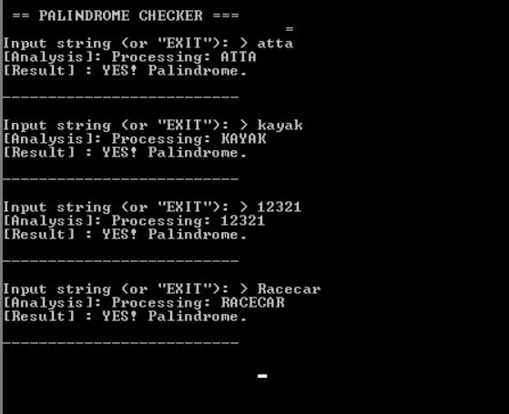
Testing & Validation - Part 1
Standard Palindromes
“atta" ➔ Pass
"kayak" ➔ Pass
Numeric Palindromes
"12321" ➔ Pass
Case Sensitivity
"Racecar" ➔ Pass (Handled via uppercase conversion)

Slide 11
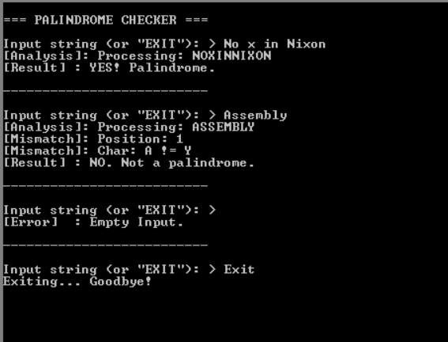
Testing & Validation - Part 2
Sentence Handling
"No x in Nixon" ➔ Pass. Sanitizer reduces to "NOXINNIXON".
Non-Palindromes
"Assembly" ➔ Not a Palindrome.
Edge Cases
Empty Input: Displays "Input was empty".
Exit Command: "EXIT" terminates program gracefully.

Slide 12
Conclusion
Summary
Value Add
Skill Demonstration
Successfully met all objectives: dynamic input, manual reversal, and robust comparison.
Input sanitisation transforms a basic exercise into a practical, real-world utility.
Proved proficiency in 8086 architecture, including register management (SI, DI, CX) and ASCII operations.

Slide 13

Q&A
Thank you for your attention.
Any Questions?
Please Don’t Ask ☺

